Slide 1
The Use of Technology In Trial
Lessons from a Zoom Bench Trial

Slide 2
The Rules of Professional Conduct
Comment 8 to Rule 1.1
RULE 1.1: COMPETENCE
A lawyer shall provide competent representation to a client. Competent representation requires the legal knowledge, skill, thoroughness and preparation reasonably necessary for the representation.
Maintaining Competence
[8] To maintain the requisite knowledge and skill, a lawyer should keep abreast of changes in the law and its practice, including the benefits and risks associated with relevant technology, engage in continuing study and education and comply with all continuing legal education requirements to which the lawyer is subject

Slide 3
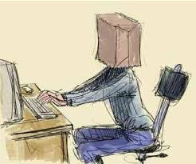
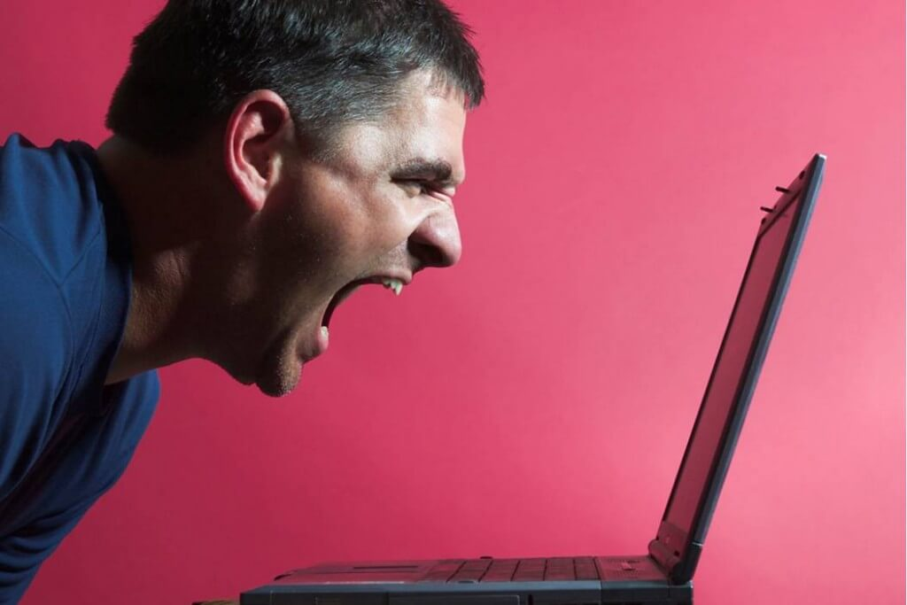
The Rules of Professional Conduct
Civility
Just because you are not in court, does mean you are not in court.
Wear courtroom attire
Give proposed orders to the other side for review before tendering to the court.
Be especially careful not to speak over one another because Zoom audio is not very good.

Slide 4
American Alliance v. Price-Parker
Chicago Daily Law Bulletin Article

Slide 5
Know the rules
Supreme Court Rule and local rules
Illinois has adopted Supreme Court Rules 45, 46, and 241 to handle remote proceedings.
The Illinois Supreme Court also has adopted Rule 206(h).
Some localities have adopted local rules governing remote proceedings, e.g. Kane and DuPage Counties.
Lake County has implemented procedures for modified in person jury trials and the COVID19 taskforce is coming out with guidelines.
Discuss these issues with the judge and understand the court’s expectations and preferences.

Slide 6
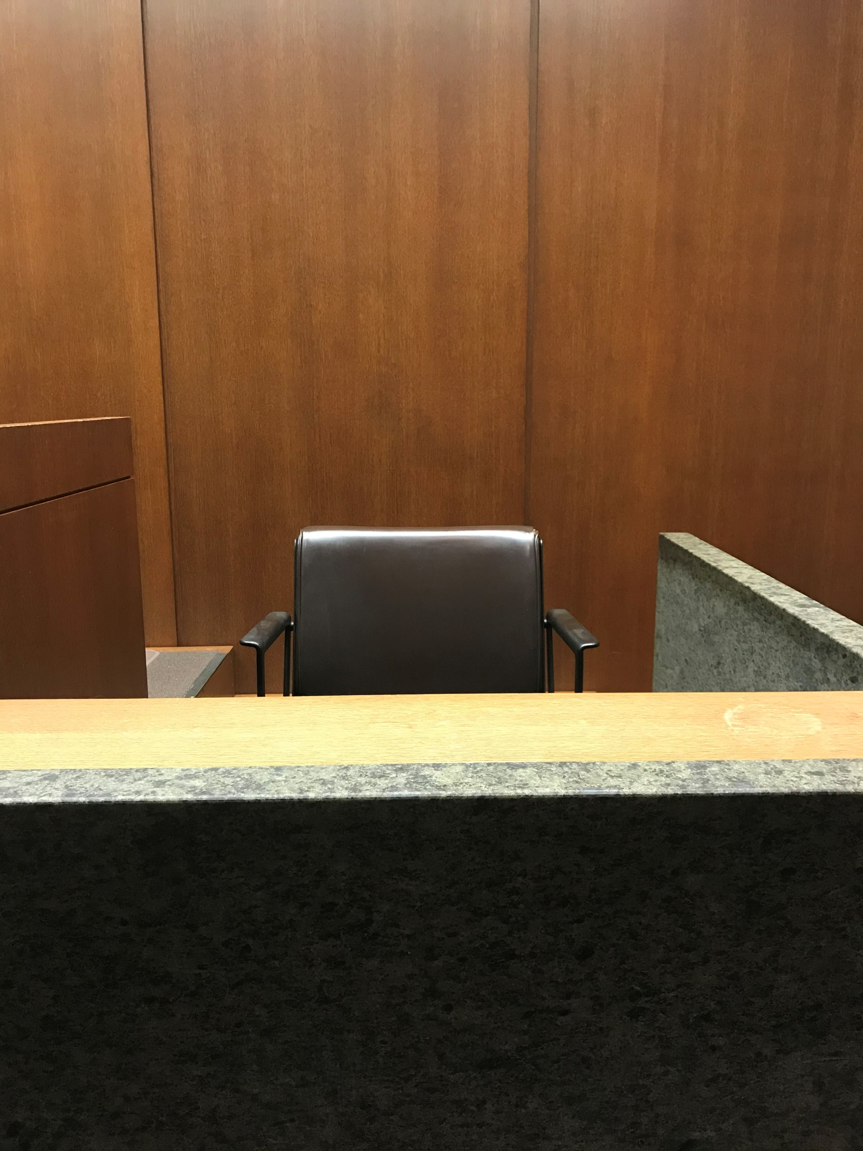
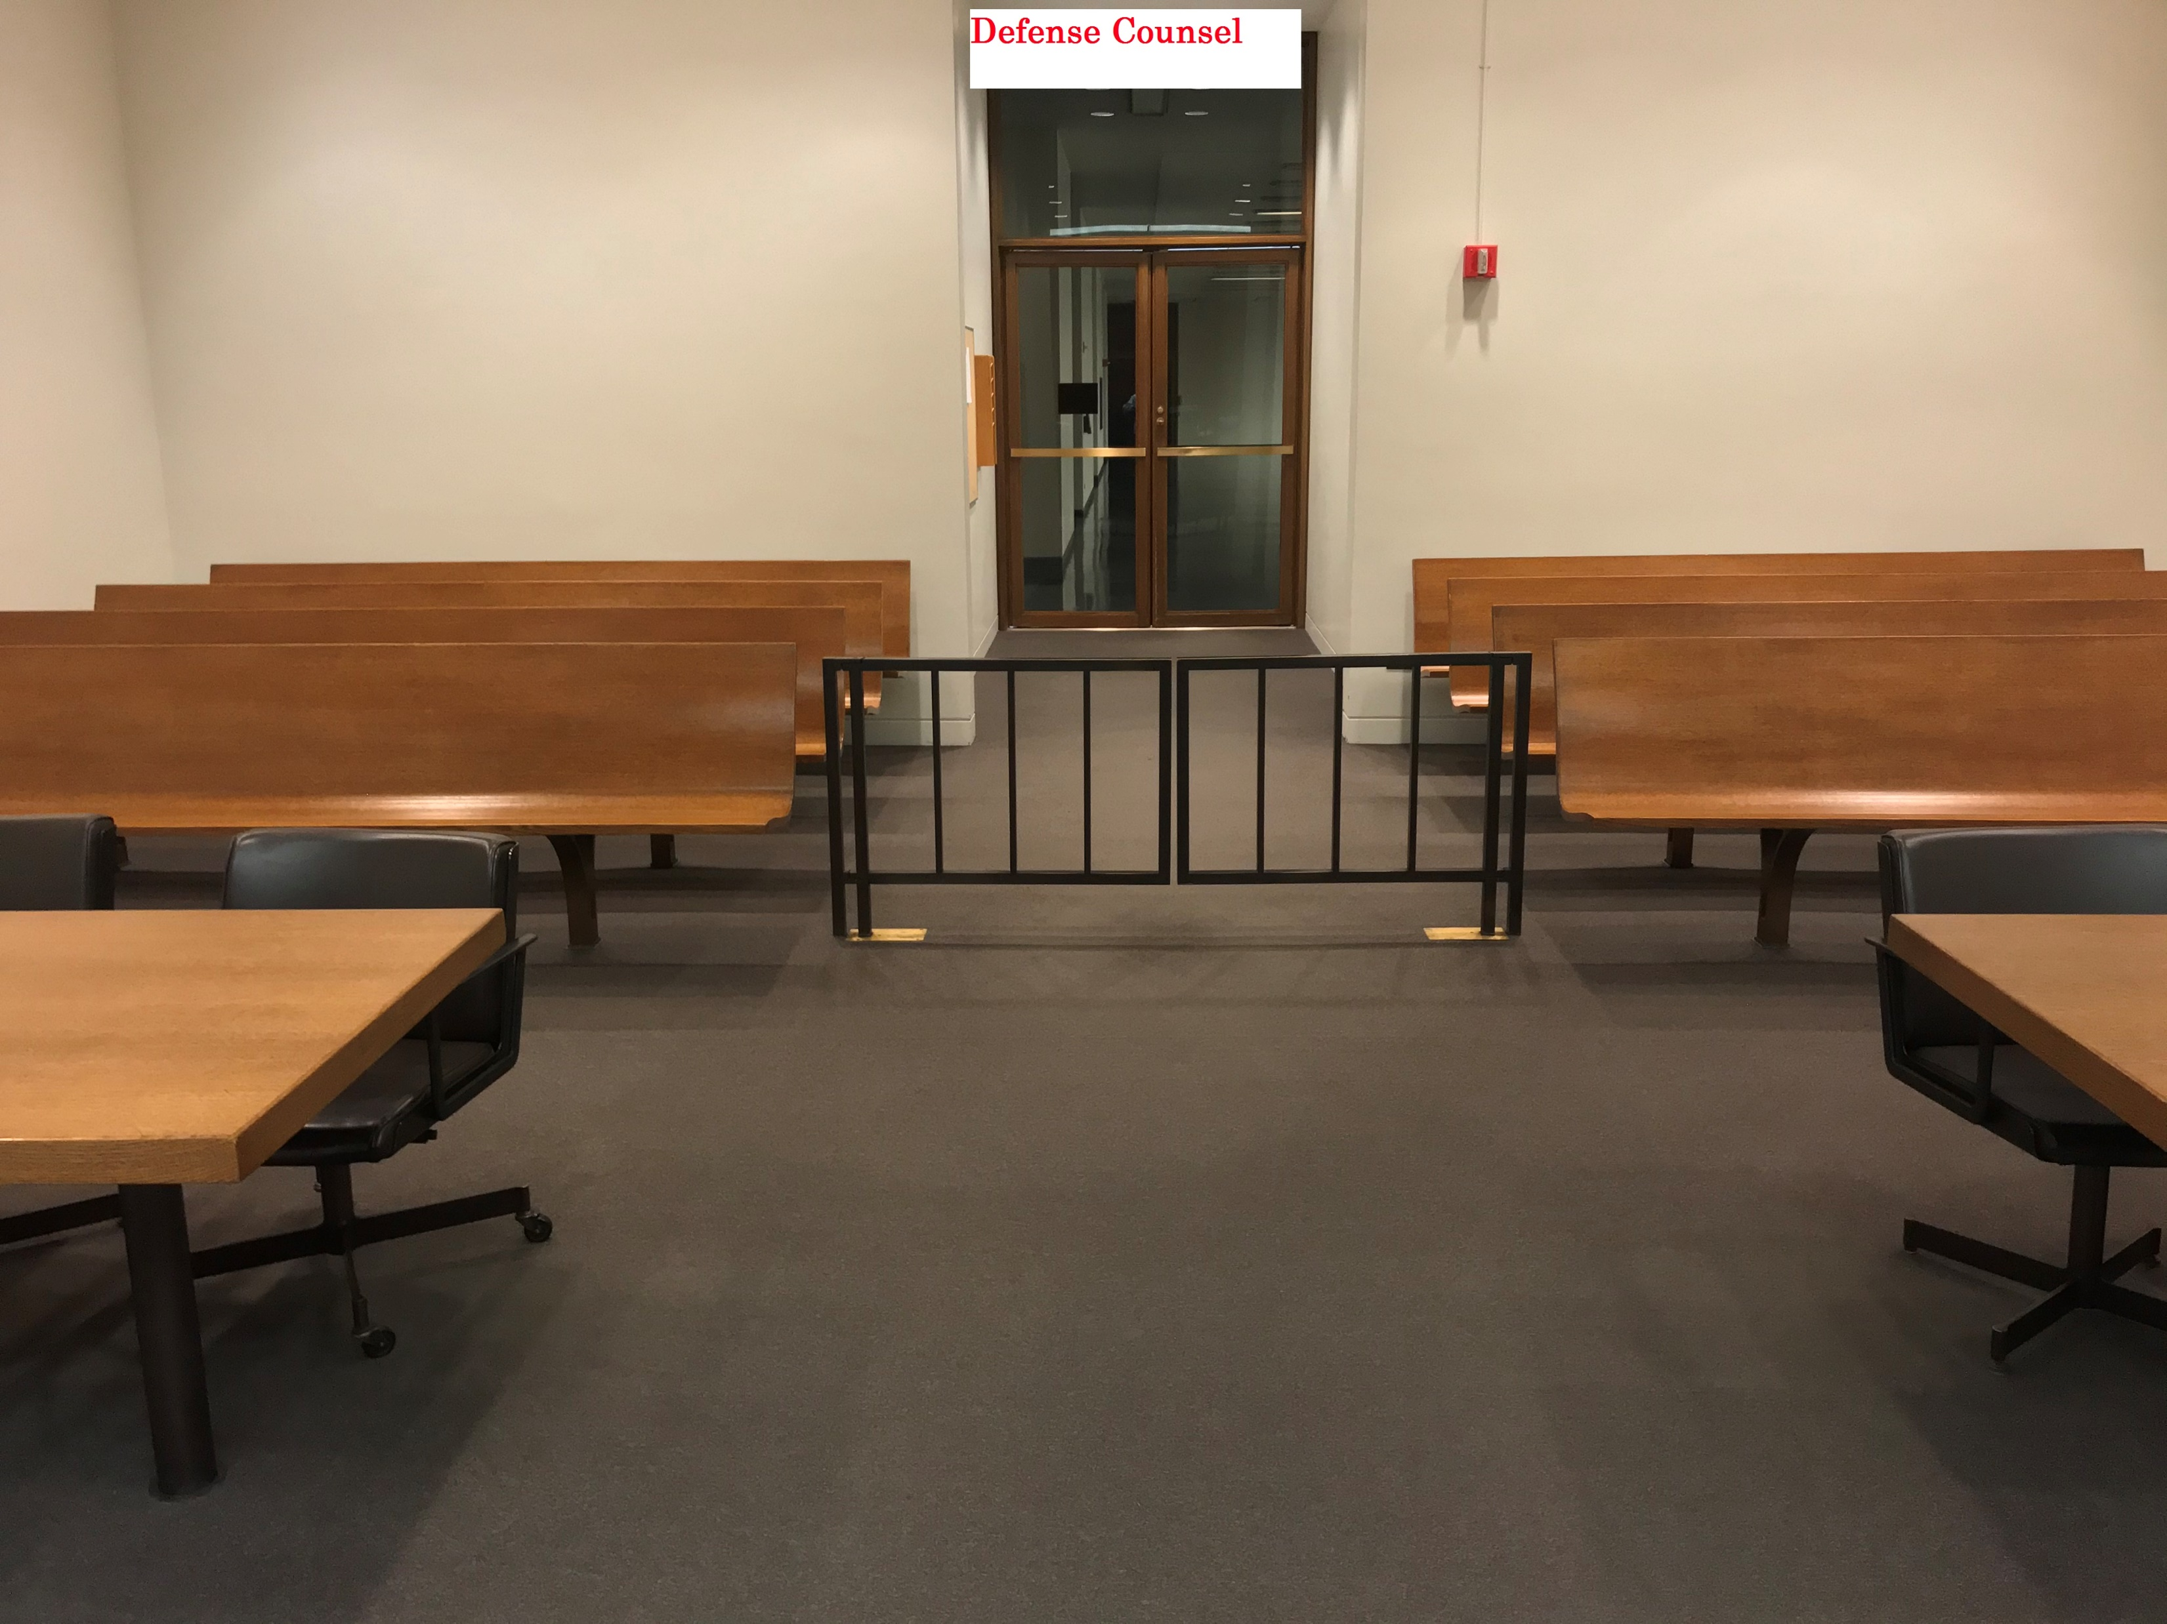
Preparation for Zoom Trial
Backgrounds
Just as you want your witnesses to dress appropriately for a live trial you want them to have appropriate backgrounds.
Judge Mitchell gave us the backgrounds he wanted us to use.

Slide 7
Preparation for Zoom Trial
Test, Test, Test
Test with the court.
Test with opposing counsel.
Test with your witnesses.
Test using the exact setup you are going to use in the location where everyone is going to be.
Especially test the share screen function to make sure everyone can see what is being shown and to make sure the court or the court’s clerk know that they have to allow the lawyers to share their screen.
Test the audio and make sure everyone can hear effectively.

Slide 8
Preparation for Zoom Trial
Have redundancy
No matter how much you test, something will go wrong.
You must have a backup for audio and video.
I recommend not relying on the Zoom audio because it is inferior to using a cell phone with headset for audio.
It is one thing to have technology fail in front of a judge, but another to have it go down before a jury.
Have a landline available for every witness and lawyer.
Have a backup cell phone number for every witness and lawyer so at least you can contact people by phone if the internet connection goes down.

Slide 9
Preparation for Zoom Trial
Other considerations
Discuss administration of the oath.
Discuss stipulations of testimony to streamline the process.
Attendance of parties during the proceedings.
Attendance of the public. It is required under Illinois law to have that available and many courts are using YouTube feeds to accomplish public access.
Use of court reporter and recording of proceedings.

Slide 10
Conducting a Zoom Trial
Etiquette
Mute your audio if you are not the lawyer who is speaking or asserting objections.
Deactivate your video if you are not the lawyer who is speaking o asserting objections.
Be especially aware of the limitations of Zoom audio and the difficultly of cross talk being understood.
Have everyone label their names in Zoom.

